Slide 1
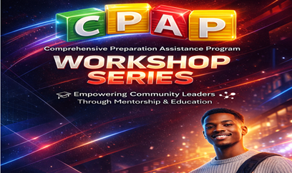

Slide 2






The Comprehensive Preparation Assistance Program

Slide 3
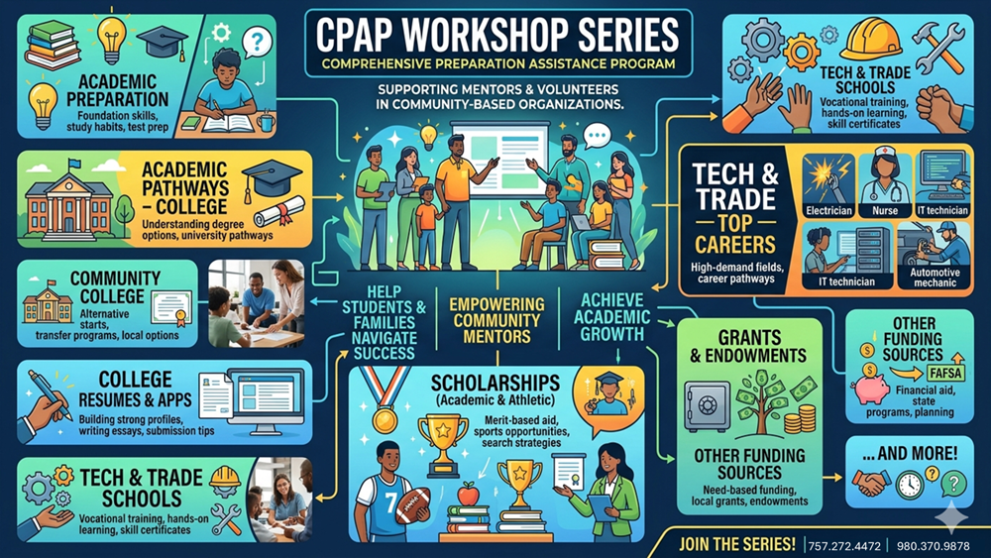

Slide 4

Comprehensive Preparation Assistance Program

Slide 5



Comprehensive Preparation Assistance Program
Comprehensive Preparation Assistance Program

Slide 6















The Power of Academic Persistence
Some deserving students who have garnered millions of dollars in scholarship money were not top athletes or came from privileged backgrounds.
The point is…you don’t have to be at the top of the class to earn a share of free scholarships and grants that are available to everyone who qualifies!
Through proper guidance, ambition and tenacity, if you put in the hard work…or labor of love… you can rise above your circumstances and see your dreams come true.
It can happen to you!
Hear are three stories among hundreds who made the effort to succeed…

Slide 7

Some deserving students who have garnered millions of dollars in scholarship money were not top athletes or came from privileged backgrounds.
The point is…you don’t have to be at the top of the class to earn a share of free scholarships and grants that are available to everyone who qualifies!
Through proper guidance, ambition and tenacity, if you put in the hard work…or labor of love… you can rise above your circumstances and see your dreams come true.
It can happen to you!
Hear are three stories among hundreds who made the effort to succeed…

Slide 8

Program Overview
  Flexible Learning Modules
  Real-World Career Pathways
  Community-Based Workshops
Some deserving students who have garnered millions of dollars in scholarship money were not top athletes or came from privileged backgrounds.
The point is…you don’t have to be at the top of the class to earn a share of free scholarships and grants that are available to everyone who qualifies!
Through proper guidance, ambition and tenacity, if you put in the hard work…or labor of love… you can rise above your circumstances and see your dreams come true.
It can happen to you!
Hear are three stories among hundreds who made the effort to succeed…

Slide 9




The University Experience
Built for Students,
Parents,
&
Community-Based
Organizations
After-school Programs
  4-Year Degree Programs
  Academic Professional Standards
  Career Advancement Goals
Some deserving students who have garnered millions of dollars in scholarship money were not top athletes or came from privileged backgrounds.
The point is…you don’t have to be at the top of the class to earn a share of free scholarships and grants that are available to everyone who qualifies!
Through proper guidance, ambition and tenacity, if you put in the hard work…or labor of love… you can rise above your circumstances and see your dreams come true.
It can happen to you!
Hear are three stories among hundreds who made the effort to succeed…

Slide 10

The Two-Year Advantage
Built for Students,
Parents,
&
Community-Based
Organizations
After-school Programs
  Foundational Associate Degrees
  Cost-Efficient Learning
  Technical Skill Development
  …and much more to explore!
Some deserving students who have garnered millions of dollars in scholarship money were not top athletes or came from privileged backgrounds.
The point is…you don’t have to be at the top of the class to earn a share of free scholarships and grants that are available to everyone who qualifies!
Through proper guidance, ambition and tenacity, if you put in the hard work…or labor of love… you can rise above your circumstances and see your dreams come true.
It can happen to you!
Hear are three stories among hundreds who made the effort to succeed…

Slide 11


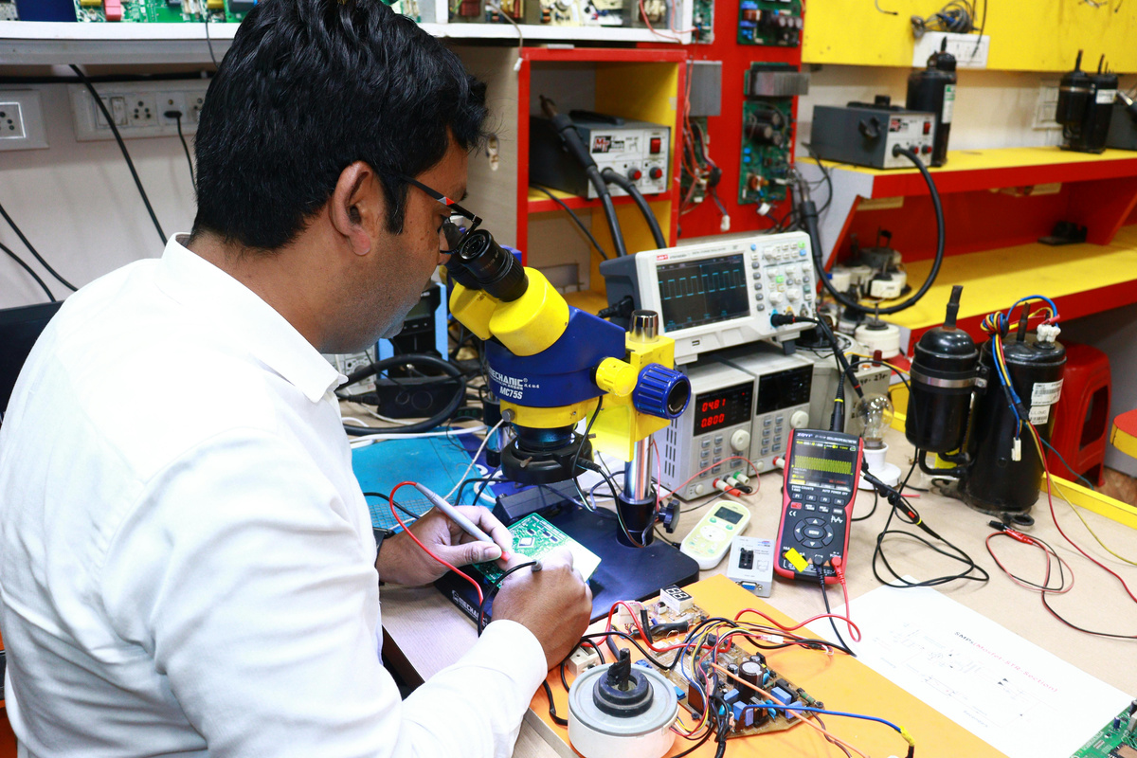

Mastering Specialized Careers
Built for Students,
Parents,
&
Community-Based
Organizations
After-school Programs
  Career & Technical Education (CTE)
  Advanced Military Pathways
  High-Demand Technical Skills

Slide 12

Fueling the Next Entrepreneur
Built for Students,
Parents,
&
Community-Based
Organizations
After-school Programs
  Entrepreneurial Mentorship
  Business Incubator Access
  Seed Funding Opportunities

Slide 13

Playing at the Next Level
Built for Students,
Parents,
&
Community-Based
Organizations
After-school Programs
  NCAA Division Standards
  Clearinghouse Registration
  PlayNAIA Academic Criteria

Slide 14
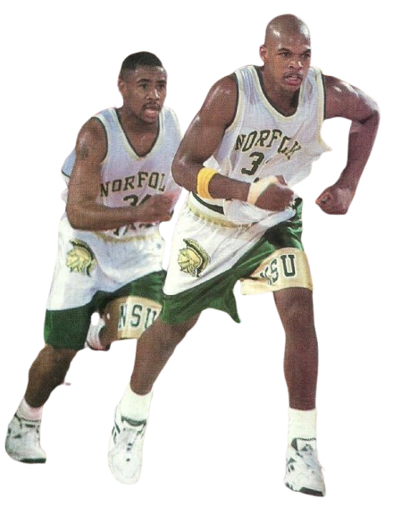
Navigating the NIL Era
Built for Students,
Parents,
&
Community-Based
Organizations
After-school Programs
  Financial Opportunities
  Professional Responsibilities
  Name, Image, & Likeness
  Pros and Cons

Slide 15

Unlock Your Free Access
Built for Students,
Parents,
&
Community-Based
Organizations
After-school Programs
  Unlimited Video Access
  Parent & Student Support
  Community Organization Tools
Workshop videos are accessible after signup!

Slide 16
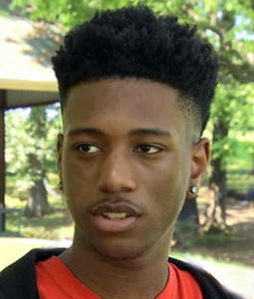
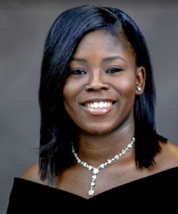

Tupac Mosley, 17, was valedictorian of the Raleigh Egypt High School senior class in Memphis, Tenn. He received over 50 scholarship offers worth more than 3 million dollars.
(He said his goal was to receive $1 million in college scholarships). And despite becoming homeless in his senior year after his father passed, the family faced eviction from their home and ended up at a camping site run by a nonprofit organization. But Tupac endured and chose to attend Tennessee State University to major in electrical engineering.
Lamyrical Harris accumulated a total of $1,244,298 in academic scholarships, making her the first million-dollar scholar in Memphis Trezevant High School’s history. Although she became a teen mother, she graduated with top honors and received offers from over 25 colleges.
Rawlin Tate Jr. made history at Woodland High School in Stockbridge, Georgia, when he finished high school with a 4.7 GPA and became the school’s first African American valedictorian. Rawlin excelled in 21 AP classes, participated in several extracurricular activities, and received over $1 million in scholarships offers. He headed to North Carolina A&T on a full academic scholarship.

Slide 17

Here are some of the Workshop Videos:
Built for Students,
Parents,
&
Community-Based
Organizations
After-school Programs
  Common App Advice
  Pathways to the Global Workforce
  Academic Preparation
  Testing Info
  Four-Year Colleges
  Community Colleges
  Technical Colleges
  Funding Sources
  Athletic Scholarships
Workshop videos are accessible to students and CBOs after signup!
  NIL
  Careers
  Hi-Tech Incubators
  Essays & Resumes

Slide 18



Comprehensive Preparation Assistance Program
Scan to Register!

Slide 19

“The gateway to unlimited access to educational opportunities”
Black College Sports & Education Foundation, Inc.©2016
A 501()3 non-profit organization
Edd J. Hayes, Executive Director Dr. Charley Flint, Education Director
The free
Comprehensive Preparation Assistance Program
Workshop
Series
Comprehensive Preparation Assistance Program
www.bcsportsfoundation.com
Scan to Register!
Scan to Register!

Slide 21
How to Write a High School Resume

Slide 22
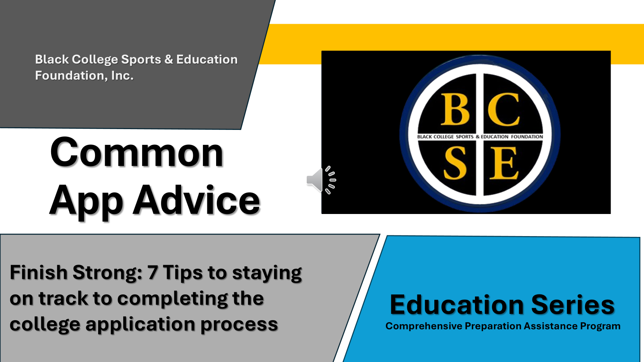

Here are some of the Workshop Videos:
  Common App Advice
  Pathways to the Global Workforce
  Academic Preparation
  Testing Info
  Four-Year Colleges
  Community Colleges
  Technical Colleges
  Funding Sources
  Athletic Scholarships
  NIL
  Careers
  Hi-Tech Incubators
Workshop videos are accessible to students and CBOs after signup!
  Essays & Resumes

