Slide 1


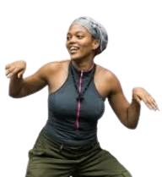





CPAP Academic Preparation Pathways
Comprehensive Preparation Assistance Program
Notes:
See “Does Career Pathways Work?” article

Slide 2

🎞️ Scene 1 – Opening (0:00–0:30)
Visual:
Bright animated sunrise. A high school appears on screen. Students of different backgrounds walk toward the building. Music is upbeat and inspiring.
Text on Screen:
“Your Future Starts Now.”
Narrator (friendly teen voice):
“High school isn’t just about passing classes. It’s about preparing for what comes next. The big question is…”
Screen freezes. Words pop up in bold letters:
“What do YOU want to do after high school?”
What do you want to do
after high school?

Slide 3

“How do you get started?
Audio / Voiceover (VO)
VO: "The big question. The one every adult asks. 'What do you want to do after high school?’”
VO: "Whether you’re aiming for the pros, the boardroom, or the operating room, we help you bridge the gap between 'now' and 'next’.”
VO: "As an initiative of the Black College Sports & Education Foundation, we specialize in opening doors—especially to the rich legacy of HBCUs.“
VO: "Your future is big. Don't leave it to chance. Let’s build your game plan together."

Slide 4


Workshop Series
A Step-by-Step Guide

Slide 5

Four-Year College Preparation

Slide 6
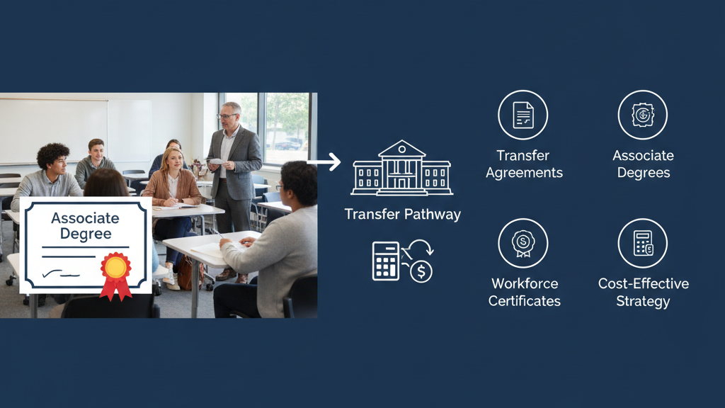
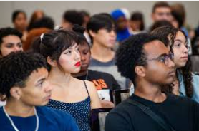

Community College:
Flexible & Strategic

Slide 7

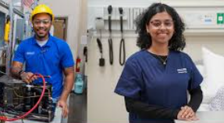
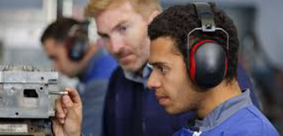
🎞️ Scene 1 – Opening (0:00–0:30)
Visual:
Bright animated sunrise. A high school appears on screen. Students of different backgrounds walk toward the building. Music is upbeat and inspiring.
Text on Screen:
“Your Future Starts Now.”
Narrator (friendly teen voice):
“High school isn’t just about passing classes. It’s about preparing for what comes next. The big question is…”
Screen freezes. Words pop up in bold letters:
“What do YOU want to do after high school?”
Technical & Trade Career
Preparation

Slide 8
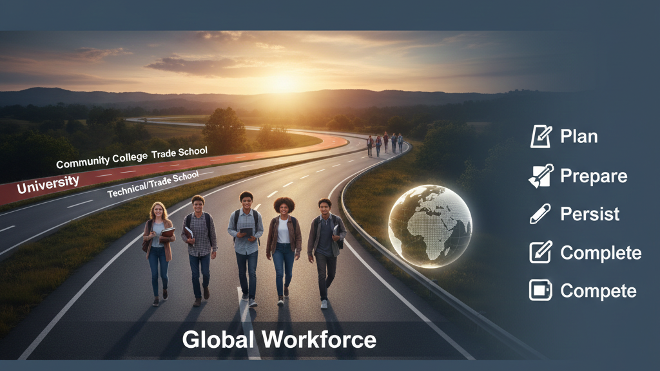


Plan
Prepare
Persist
Compare
Complete
Join the

