Slide 1
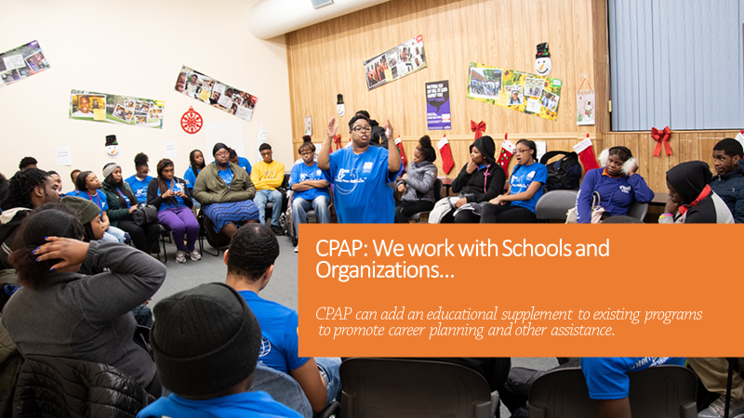
CPAP* and Community-Based Organizations
*The COMPREHENSIVE PREPARATORY ASSISTANCE PROGRAM
An Overview
Black College Sports & Education Foundation, Inc. ©2016

Slide 2
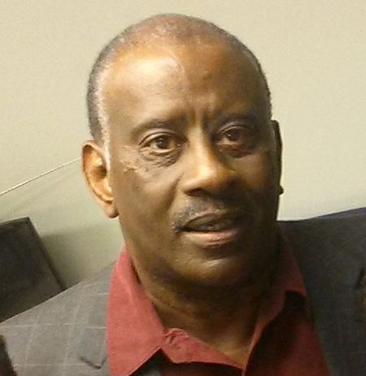
Welcome to CPAP
Welcome to CPAP
Comprehensive Preparatory Assistance Program
Community-Based Organizations are the hubs for many neighborhoods and communities they serve. Do you have a need to expand the education component of your program?
Our educational program can provide another layer of support to your community-based educational programs.
The nonprofit Black College Sports & Education Foundation has a free Comprehensive Preparatory Assistance Program (CPAP), a tool with educational resources for new or existing programs. CPAP can help enrich the experience of our youth who seek to further their education.
Please take a minute to see what CPAP has to offer. Thank you!

Slide 3
CONTENTS
CONTENTS
The Free Comprehensive Preparatory Assistance Program (CPAP)
Introduction to CPAP
CBOs + CPAP
CPAP
Communications Tools
Contact Us

Slide 4
What Is CPAP?
FREE!
We help
students and athletes
to navigate the road to
higher education and beyond.
COMPREHENSIVE
PREPARATORY
ASSISTANCE
PROGRAM
(CPAP)

Slide 5
CPAP: We Listen…We Can Help
CPAP: We Listen…We Can Help
The free Comprehensive Preparatory Assistance Program (CPAP) offers support for Community-Based Organizations that provide educational programming.
We monitor education progress with fundamental tools that interact with students and their families.
Find out how your organization can benefit from CPAP educational resources. Contact: www.bcsportsfoundation.com
Different folks, different strokes…
Everyone may have different educational aspirations, but whether college, technical or trade schools, CPAP offers a one-stop resource center with virtual assistance and much more.

Slide 6
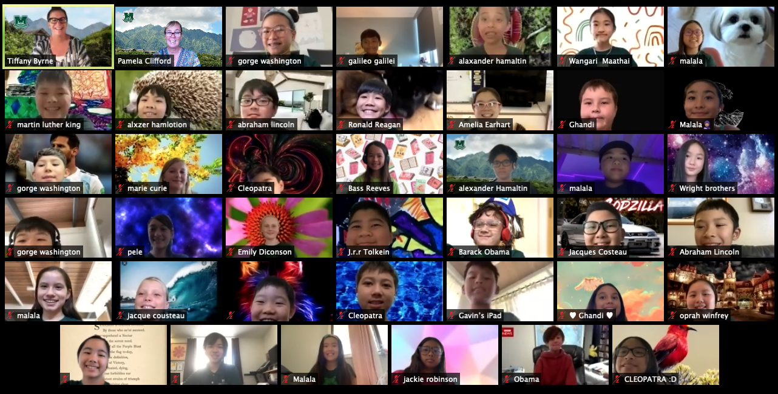
5 Reasons to Work with a CBO
CPAP: 5 Reasons to Partner with CBOs
You provide educational and recreational services for youths and adults.
You are the hub of community activities.
You have a unique and important insight into the challenges and opportunities facing children and families in their neighborhood.
You provide advocacy services for the diverse ethnic and cultural groups in the community.
You have the trust of your community.
The CPAP educational component can add value to your programs by helping students and athletes to stay on track, especially during this pandemic times.

Slide 7
A Program Within Your Program
A Program within Your Program
CPAP is designed to work with community-based organizations that sponsor after-school activities such as after school tutoring and homework, sports and social skills.
Academics
Social Skills Training
Emotional Support
Recreation
Community Support
For now, virtual communications allow us to offer career building skills, next-level education preparation and much, much more as an added component of your program agenda.
CPAP is an educational supplement that can be tailored to fit your program needs. The Career Building program is virtual* and allows for interaction with students, staff and family members.
Don’t have a program? CPAP can help.
*Due to the Covid conditions, all interactions are virtual communications until further notice.

Slide 8
Overcoming Challenges
Overcoming Challenges
We realize serving the underserved can be a challenge.
CPAP educational resources are available at no cost to the students and athletes.
We can deliver a virtual wealth of information and support to community-based groups online through our virtual communications network.
CPAP supports the efforts of afterschool services. This added benefit can encourage students to utilize their time more productively as they
pursue their goals.

Slide 9
How’s It’s Done?
How It’s Done?
CPAP offers students and CBOs access to the Resource Center which provides educational tools, FAQs, tutorials, webinars, videos, social media, emails, and more…
Students from 6-12 grades are eligible for the program.
They are rated in the 6-8, 9-10, 11-12 grade categories.
(Essential Student Information is provide to each category ).
Students, their families and CBOs have access to advisors. We encourage family participation throughout the process.
Students register with CPAP online…quick and simple. They will have access to their respective portal.
Students and CBOs can access the CPAP Resource Center which houses educational tools, Frequently Asked Questions, tutorials, webinars, videos, social media, emails, and more.
CPAP creates a Personal folder …which contains a student’s bio…school data…personal interview information …progress tracking…all information is highly secured.
At this point, the Education Team develops a Progress Tracking folder that starts at the point the student is registered.

Slide 10
How to Access the CPAP Portal
How to Access the CPAP Portal
(After registration, log on with username and password).
Log in to Section portal:
Section Includes:
Tutorials
Videos, Webinars
Career Building Tools
Athletics
Extracurricular Activities
More…
CPAP enrollees and CBOs can access the portals
11-12 grades:
Tutorials
Videos, Webinars
Career Building Tools
Athletics
Extracurricular Activities
More…
Essential Student Information packets are modules applicable to grade (section) categories.
9-10 grades:
6-8 grades :
Tutorials
Studies
Sports, Games
Extracurricular Activities
More…

Slide 11
Inside CPAP
Inside CPAP
Here is a abbreviated directory of higher education databases available for eligible users.
Full-time College
Community College
Technical College
Technical Training Schools
Bachelor of Arts
Bachelor of Science
Bachelor of Fine Arts Master’s degrees Doctoral degrees
Junior Colleges
Associate degrees
Liberal Arts Colleges
Technical Institutes Professional Schools
Nursing
Women’s
Tribal
Associate degrees Health Care degrees
Computer technology
Automotive technology
Business Administration Web Development
Cosmetology
Massage Therapy
Carpentry
Plumbing
Auto Repair
Masonry
Welding
Other Topics:
Applications
Resumes
Essay Writing
Athletic Eligibility
Career Assistance
Funding Sources

Slide 12
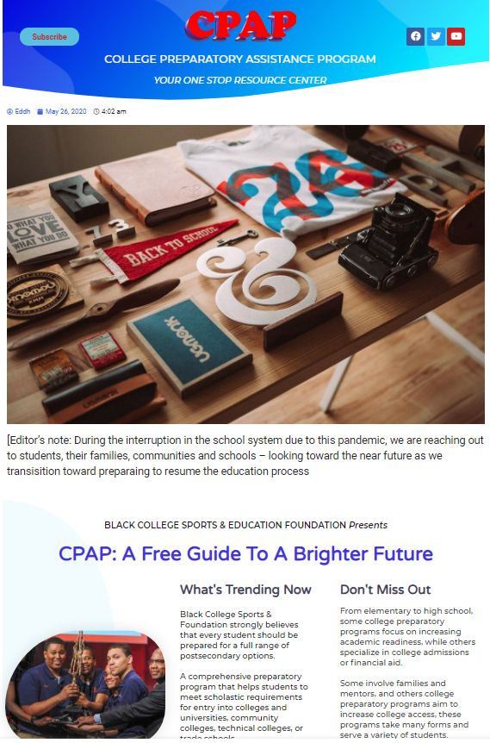
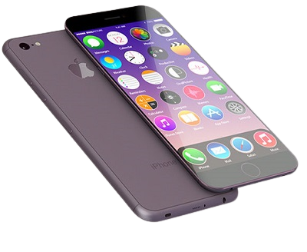
Communications Tools
Communications Tools
CPAP is a virtual learning universe with tutorials, webinars, podcasts, newsletters, social media and more…
www.bcsportsfoundation.com
Webinars
Video Instructions
Podcasts
Meeting Places
Online Chats
See how sports and education worked together, visit The Black College Sports History & Legends website.

Slide 13
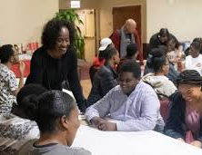
Contact Us
Contact Us
Community - Based Organizations can interact with CPAP with in-person and virtual sessions.
Our collaborations include scheduled meeting places and other social media outlets.
We are excited to hear from you! Please contact us at:
BCSEF Edd J. Hayes, Executive Director edd@bcsportsfoundation.com (770) 376-6114 (757) 272-4472
Black College Sports & Education Foundation, Inc ©2016 A nonprofit 501(C)(3) organization

