Slide 1
COMPREHENSIVE PREPARATION ASSISTANCE PROGRAM
HOW TO REGISTER
A Step by Step Guide for Applicants
Students | Parents | Guardians
BLACK COLLEGE SPORTS & EDUCATION FOUNDATION, Inc. © 2017
1097 Commons Court, Jonesboro, GA 30238 | (770) 376-6114 | edd@bcsportsfoundation.com
Notes:
Complete registration form and Click “Sign me up!”

Slide 2
Progress Bar
COMPREHENSIVE PREPARATION ASSISTANCE PROGRAM
STEP 1
SIGN UP!
Go to: www.bcsportsfoundation.com
BLACK COLLEGE SPORTS & EDUCATION FOUNDATION, Inc. © 2017
1097 Commons Court, Jonesboro, GA 30238 | (770) 376-6114 | edd@bcsportsfoundation.com
Notes:
Complete registration form and Click “Sign me up!”

Slide 3
Agency Quotable Design
Progress Bar
CPAP REGISTRATION
(CLICK ON THE DROPDOWN LINK)
OR CLICK LINK ON BUTTON
Notes:
Click on “CPAP Registration” link

Slide 4
Progress Bar
COMPREHENSIVE PREPARATION ASSISTANCE PROGRAM
STEP 2
Complete Registration Form
Notes:
After confirmation/Congratulation, an email will be sent to recipient

Slide 5
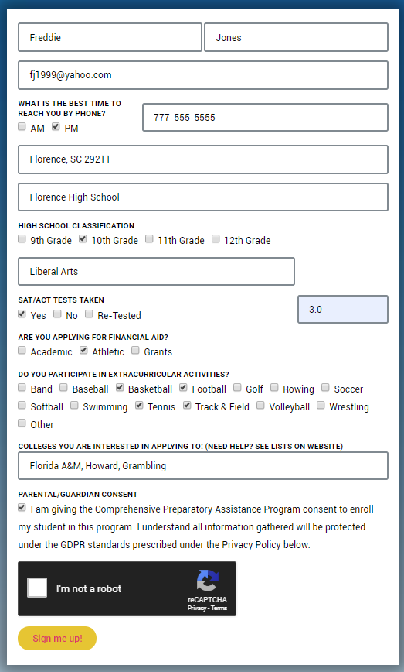
Progress Bar
Be sure to include all Required* information.
Parent/Guardian: check the “parent/guardian consent” button at the bottom of the form!
Click “Sign me up!”
That’s it!
Notes:
After confirmation/Congratulation, an email will be sent to recipient

Slide 6
Progress Bar
Look for a Confirmation Email
Notes:
After confirmation/Congratulation, an email will be sent to recipient

Slide 7
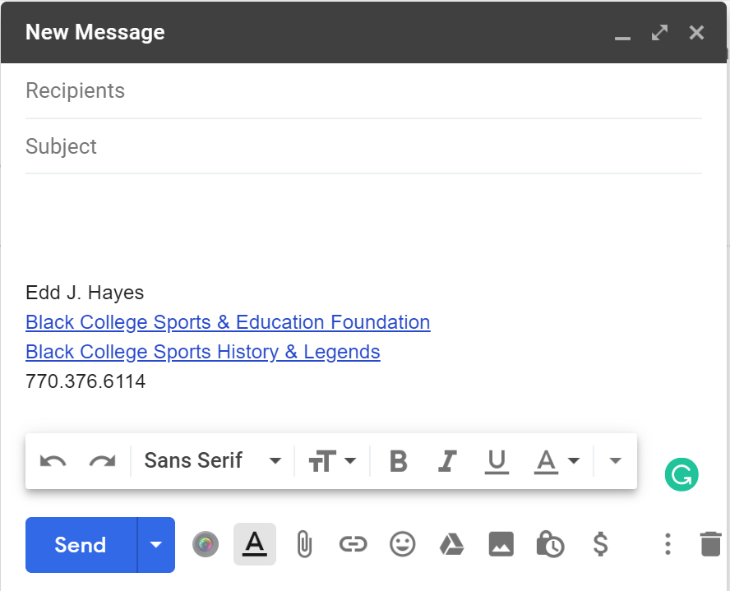
Progress Bar
John Doe X
Welcome to CPAP!
You have enrolled in the Comprehensive Preparation Assistance Program!
To access your account, use your email address and the following password: XXXXXXXXX
For security purposes, do not share this password with anyone except your parents or guardian. A guided tour of the sections will be available after login.
For more details, contact us if needed.
Good luck!
Notes:
After confirmation/Congratulation, an email will be sent to recipient

Slide 8
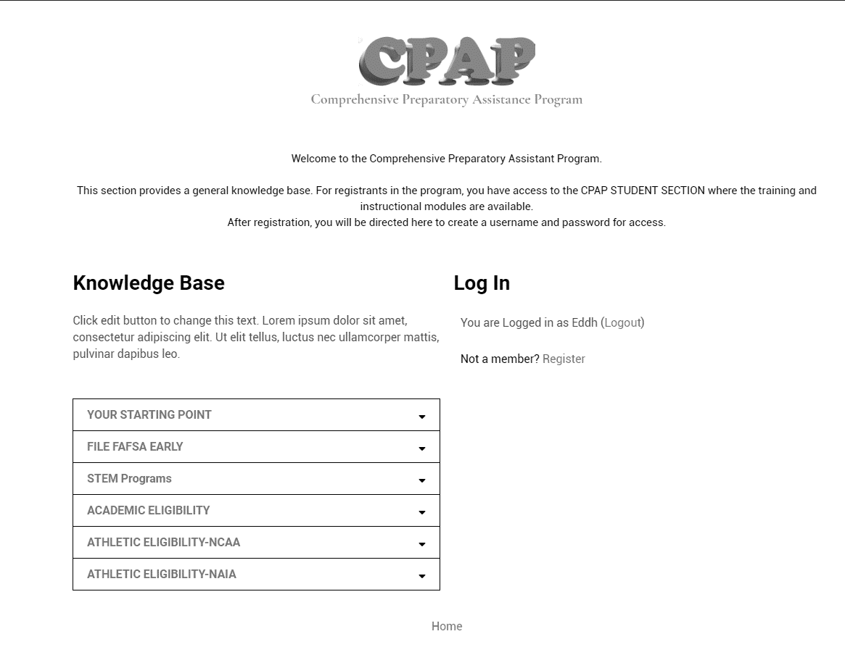
STEP 4
“Log in” page
will give you access to
the CPAP Content Section on the website.
Notes:
After confirmation/Congratulation, an email will be sent to recipient

Slide 9
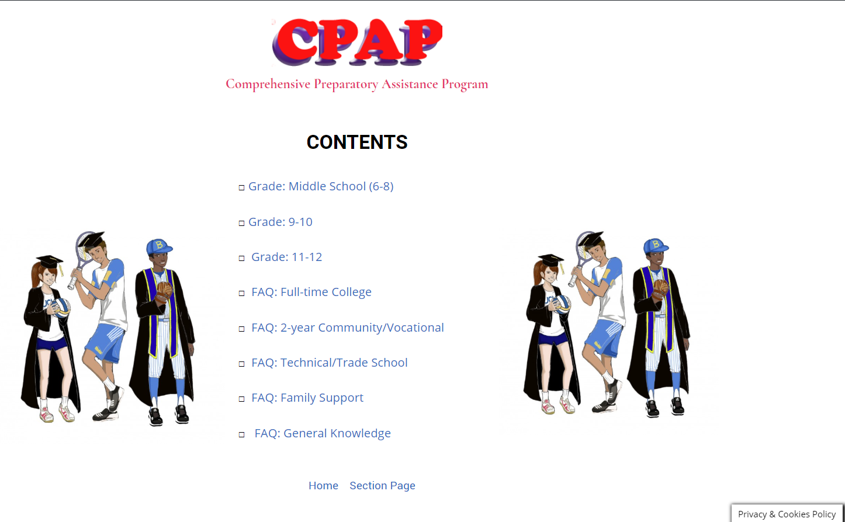
Progress Bar
STEP 5
What’s Next?
Your sign in credentials will allow you to sign into your section: (6-8, 9-10, 11-12). You cannot access the other sections.
Once you have accessed your section, you will find a directory of information relevant to you: tutorials, articles, videos, quizzes, and much more.
Also included is a “Chat” link you connect to your mentors directly. We encourage you to use it to ask questions, make inquiries and more.
Notes:
After confirmation/Congratulation, an email will be sent to recipient

Slide 10
What’s behind the Curtain?
COMPREHENSIVE PREPARATION ASSISTANCE PROGRAM
Notes:
After confirmation/Congratulation, an email will be sent to recipient

Slide 11
COMPREHENSIVE PREPARATION ASSISTANCE PROGRAM
SECTIONS CONTENTS
Your Progress Tracker
Questions & Answers
Education Guidelines
Video |Tutorials
Live Chat
Athletic
Guidelines
Shared Links for:
Full–Time College
Community College
Technical College
Trade Schools
Career
Guidelines

Slide 12
COMPREHENSIVE PREPARATION ASSISTANCE PROGRAM
SIGN UP TODAY!…
www.bcsportsfoundation.com
We want to hear from you!
Got a question?, contact us at edd.j.hayes@gmail.com
or call: 770-376-6114…Chat with us!
BLACK COLLEGE SPORTS & EDUCATION FOUNDATION, Inc. © 2017
1097 Commons Court, Jonesboro, GA 30238 | (770) 376-6114 | edd@bcsportsfoundation.com
Notes:
After confirmation/Congratulation, an email will be sent to recipient

